Slide 1
HOTEL APPLICATION

Slide 2
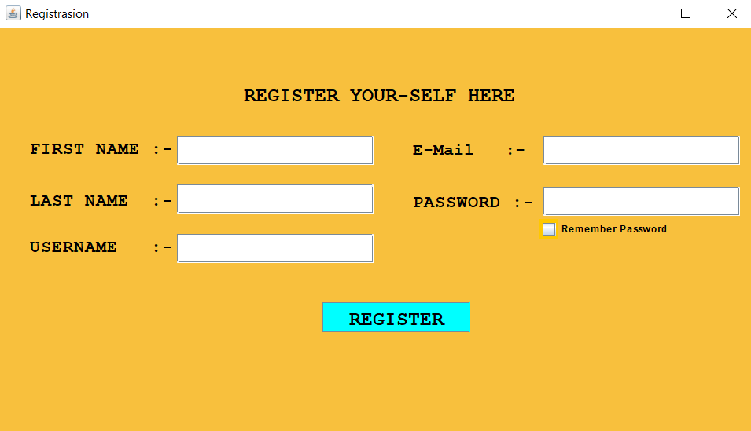
Application First Page Registrasion Page

Slide 3
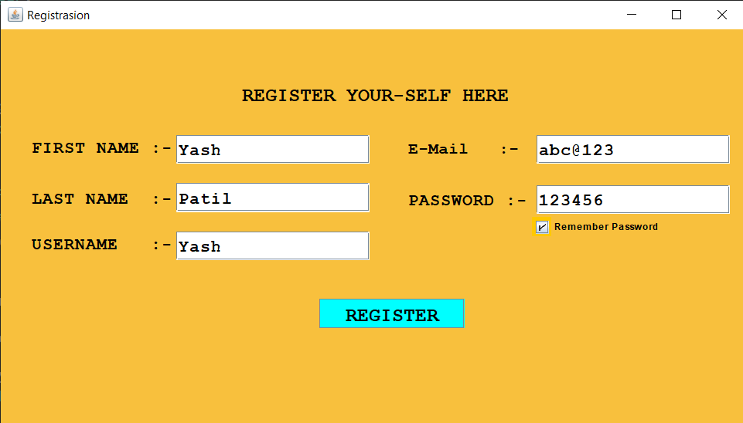
Have To Fill Up All Details
And Click On Register Button

Slide 4
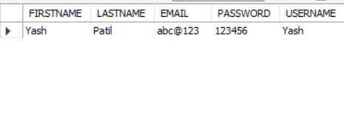
All The Details Going To Save Sql Tabel

Slide 5
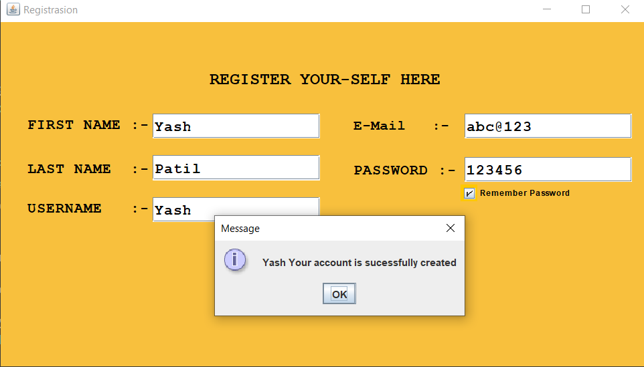
One Message Box Open
Click On Ok

Slide 6
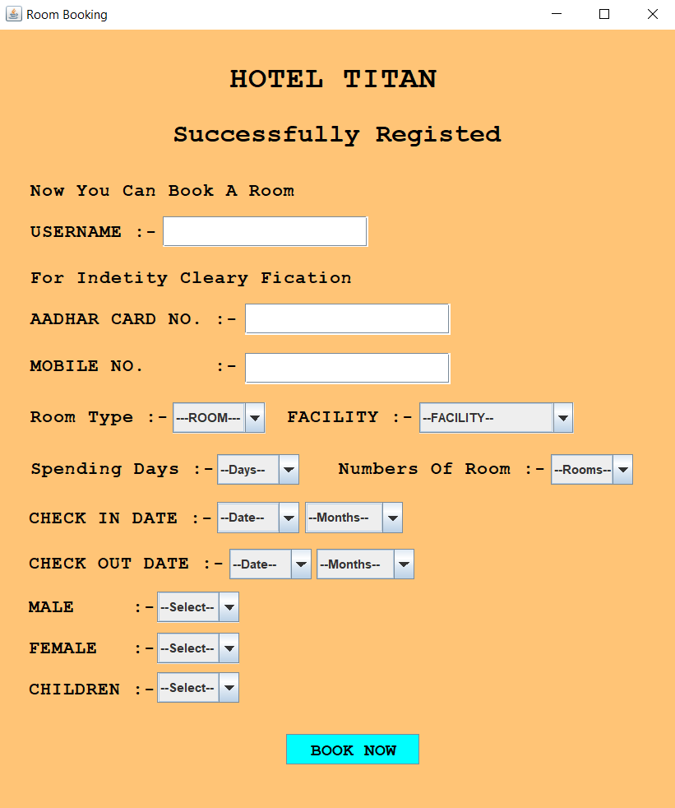
With Click Of Ok Button Second Page Opend

Slide 7
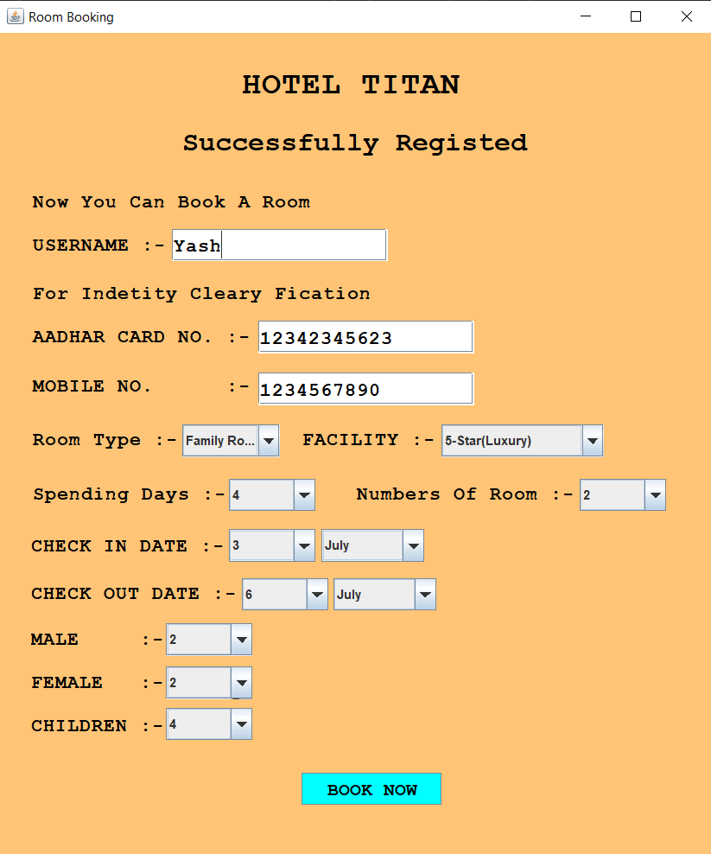
Fill Up All The Details

Slide 8
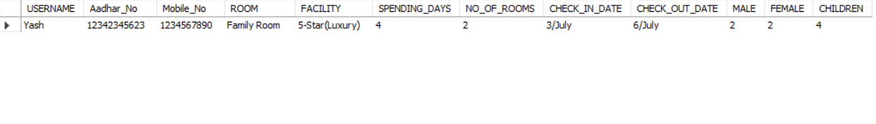
All The Details Going To Save Sql Tabel

Slide 9
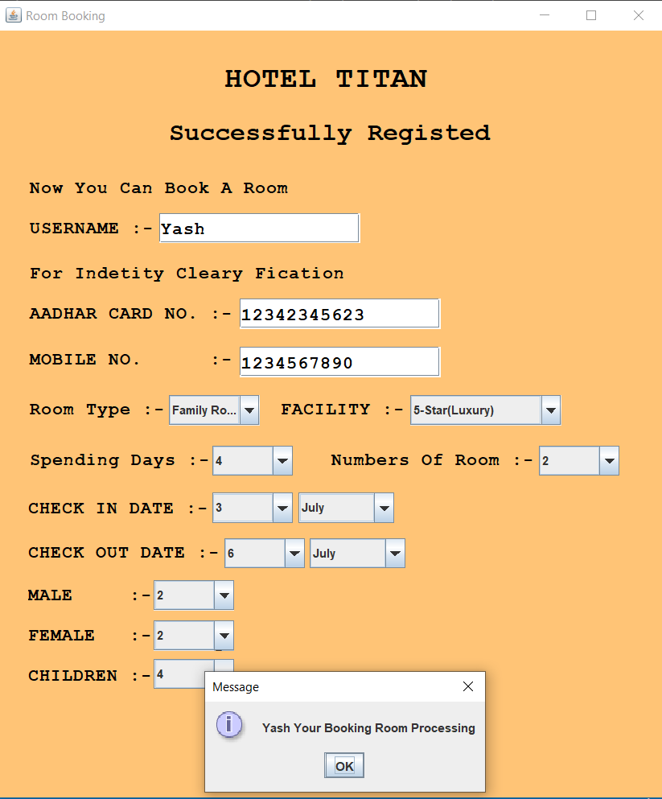
One Message Box Open
Click On Ok

Slide 10
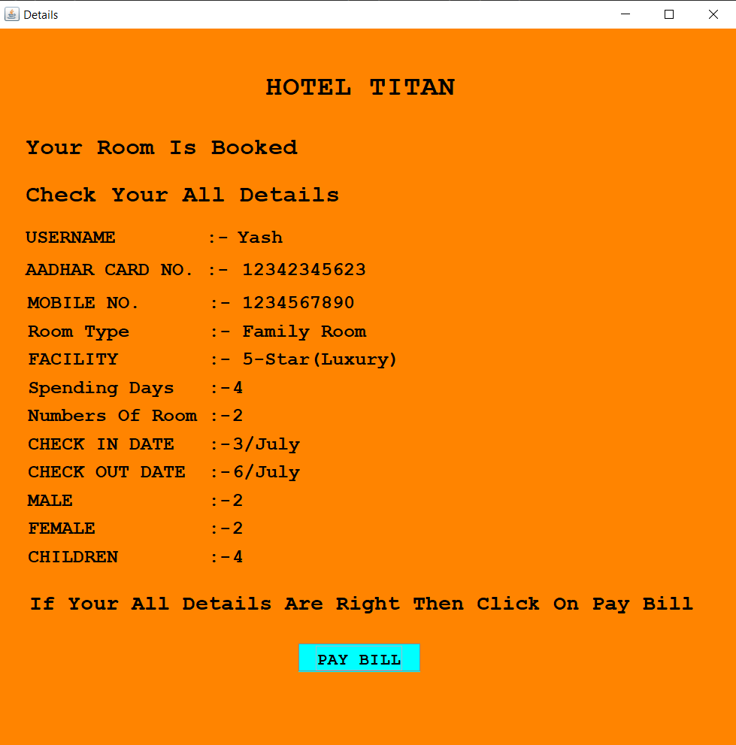
With Click Of Ok Button
Last Page Opend

Slide 11
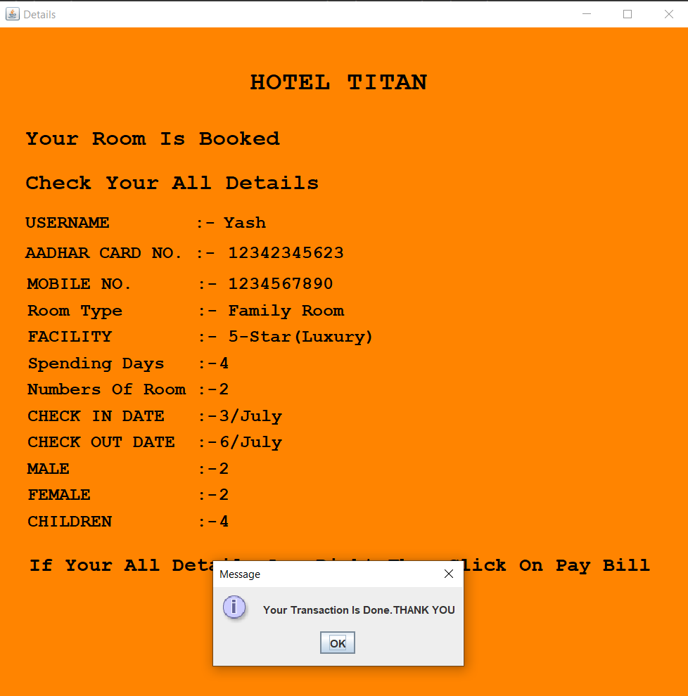
One Message Box Open
Click On Ok
And Application Going to Close

